Slide 1
Translating Embeddings for
Modeling Multi-relational Data
배지환

Slide 2
01
Background
02
Introduction
03
Model
04
Experiment
Table of
Contents
05
Implementation
06
Conclusion

Slide 3
Background
Translating Embeddings for
Modeling Multi-relational Data

Slide 4
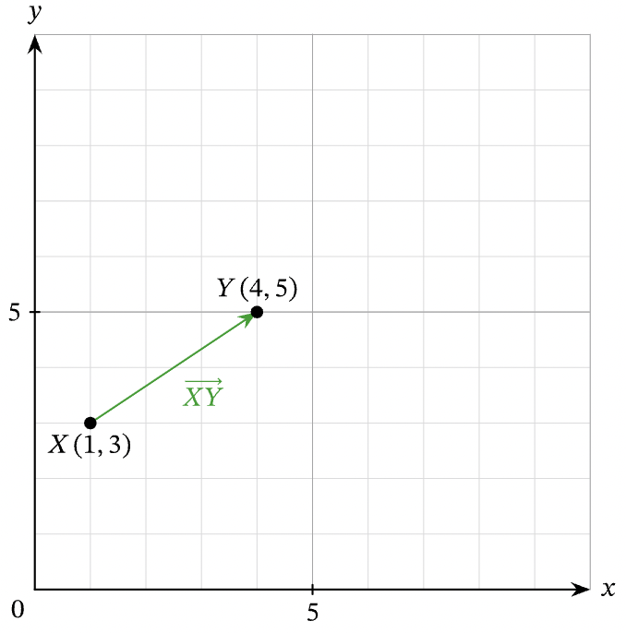
Background
What is
Translation?
Type of transformation that takes each point in a figure and slides it the same distance in the same direction.

Slide 5
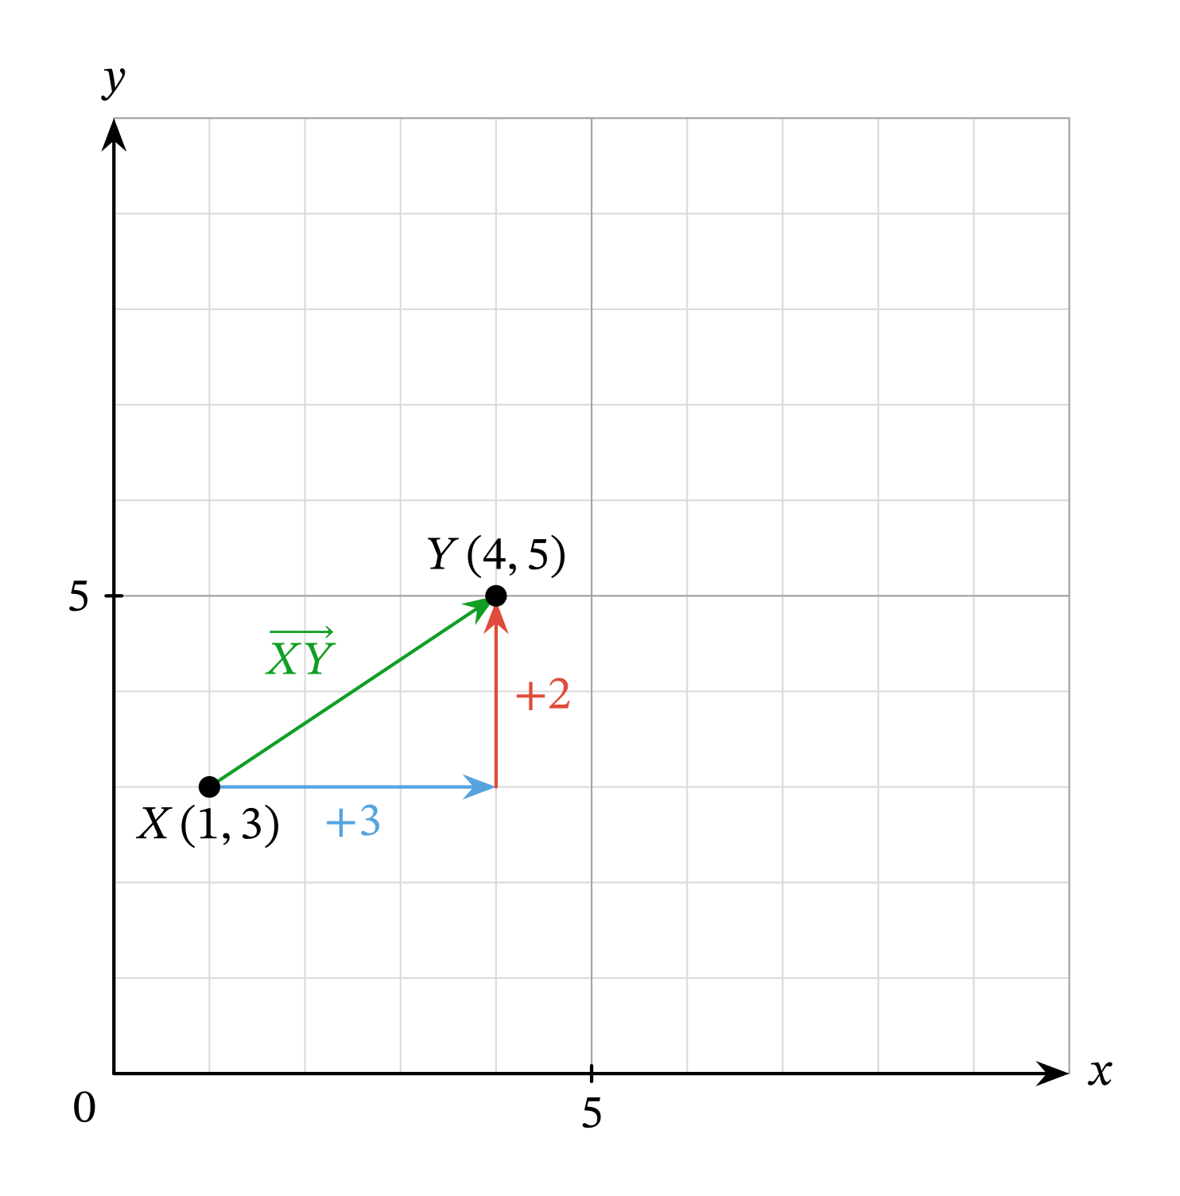
Background
What is
Translation?
(𝑥,𝑦)→(𝑥+3,𝑦+2)

Slide 6
Background
Translating Embeddings for
Modeling Multi-relational Data

Slide 7
Word Embedding
1
2
3
4
Man
Woman
King
Queen
Man | 1 | 0 | 0 | 0
Woman | 0 | 1 | 0 | 0
King | 0 | 0 | 1 | 0
Queen | 0 | 0 | 0 | 1

Slide 8
Word Embedding
1
2
Royalty
Femineity
Man | 0 | 0
Woman | 0 | 1
King | 1 | 0
Queen | 1 | 1

Slide 9
Background
Translating Embeddings for
Modeling Multi-relational Data

Slide 10
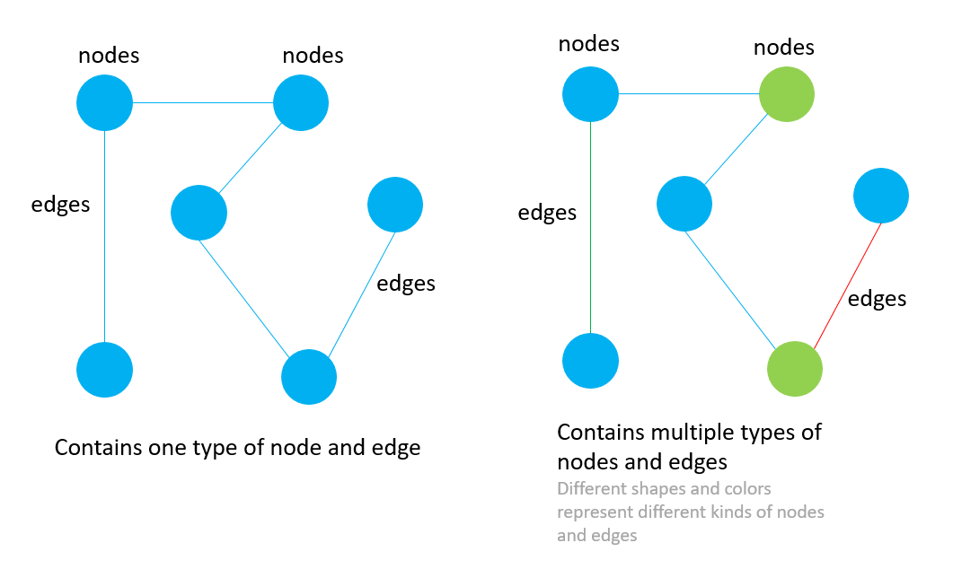
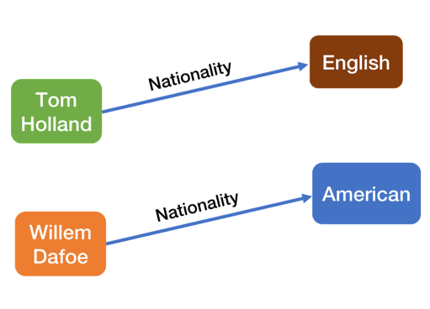
Multi-Relational Data
Classic Graph Structure
 | Text Here
 | Text Here
 | Text Here
 | Text Here
 | Text Here
 | Text Here
Multi-Relational Structure
 | Text Here
 | Text Here
 | Text Here
 | Text Here
 | Text Here
 | Text Here

Slide 11
Introduction
Set of triplet
Given a training set S of triplets
(h, l, t) composed of two entities
h, t ∈ E (the set of entities) and a relationship l ∈ L (the set of relationships), our model learns vector embeddings (value in R^{k}) of the entities and the relationships.
Option B
Corrupted Set
h + l ≈ t

Slide 12
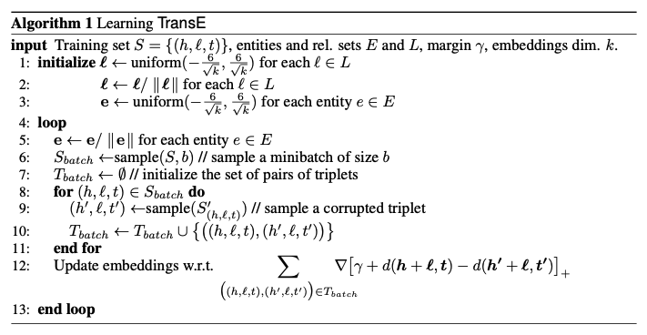
Of TransE
Algorithm

Slide 13
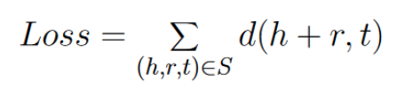

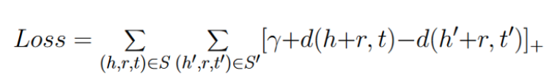
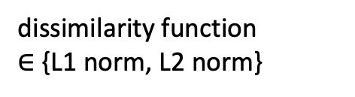
Loss Function
dissimilarity function
$∈$ {L1 norm, L2 norm}
01
01
02
03

Slide 14
Why is the margin term included?
d(h+r,t)
Relation r
TAIL
H
equal
TAIL
d(h’+r,t’)
CORRECT HEAD
H’
Relation r
CORRUPTED
HEAD

Slide 15
Related Works
Structured Embeddings
SE embeds entities into R^{k}, and relationships into two matrices L₁ ∈ R^{k×k} and L₂ ∈ R^{k×k} such that d(L₁h, L₂ t) is large for corrupted triplets (h, l, t) (and small otherwise).
L₁ Embedding matrix
H
R^{k×k} Subspace
T
Add Text
Add Contents Title
L₂ Embedding matrix

Slide 16
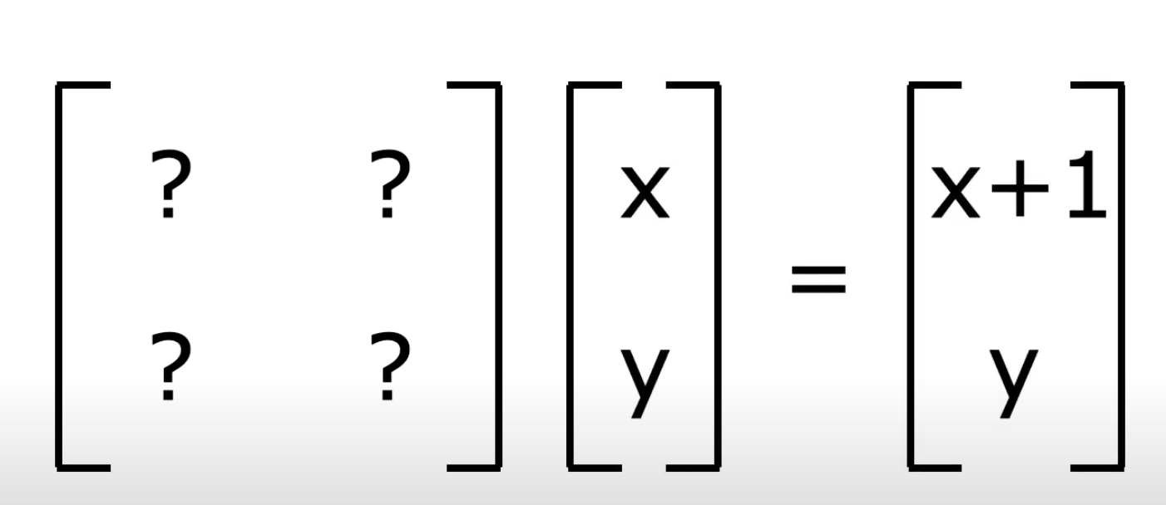
Affine Transformation
d(L₁h, L₂t) VS d(h + l, t)
SE TransE

Slide 17
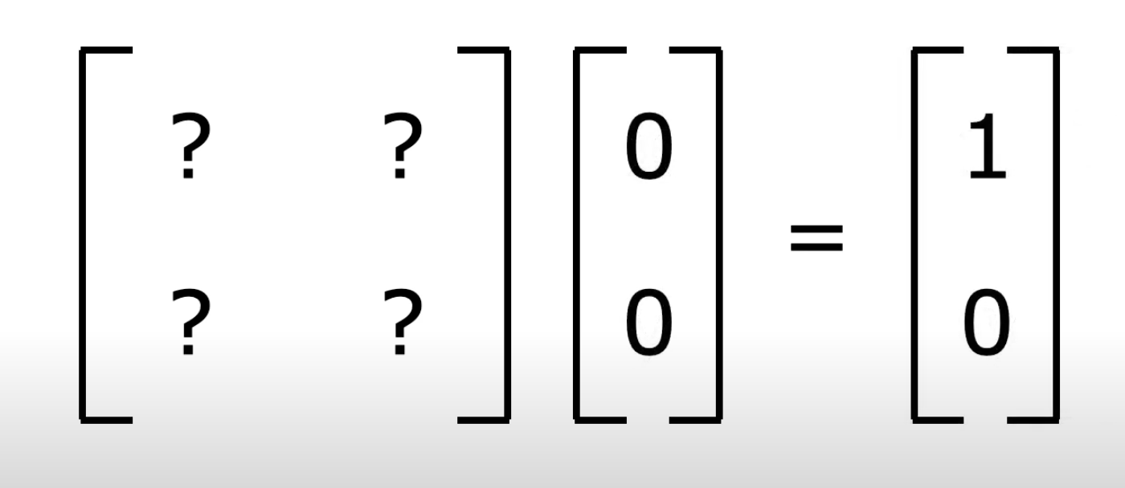
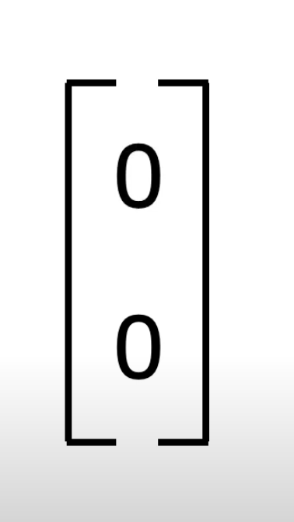
Affine Transformation
Not Feasible!

Slide 18
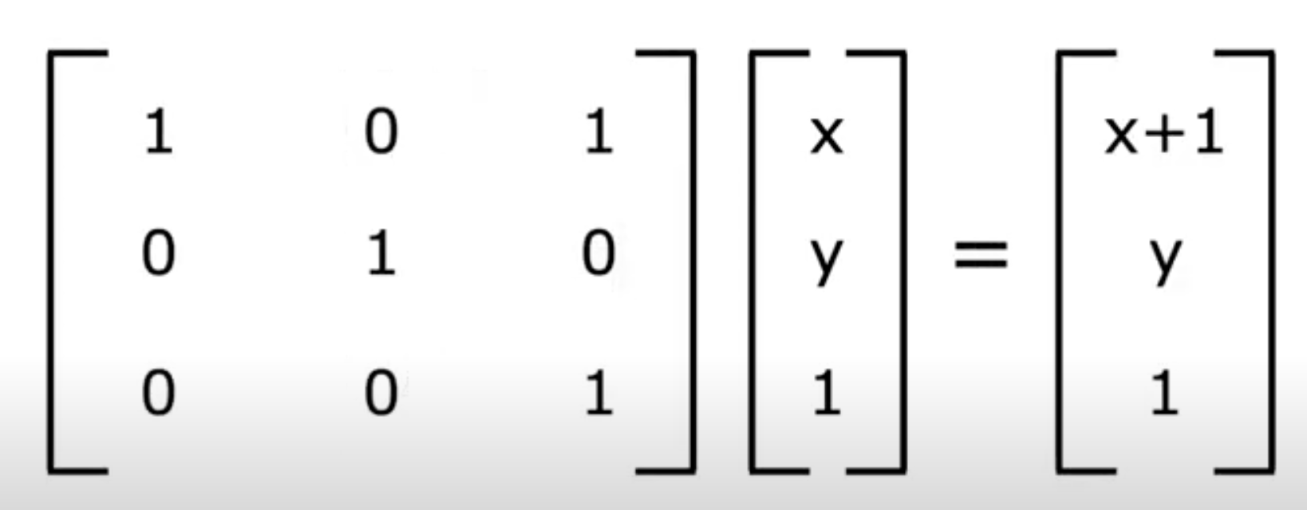
Affine Transformation
Translated by increasing dimension

Slide 19
Related Works
When L₁ reproduce translation and L₂ = Identity Matrix,
Structured Embeddings = TransE
Structured Embedding has greater expressiveness than TransE
Add Contents Title

Slide 20




Neural Tensor Model
, where L ∈ R^{k×k}, L₁ ∈ R^{k} and L² ∈ R^{k}
‘Learning score’ for special case of this model
Score is lower scores for corrupted triplet
If we consider TransE with the squared Euclidean distance as dissimilarity function, we have:
does not play any role in comparing corrupted triplets
Neural Tensor Model Score,
where L is the identity matrix, and l = l1 = l2
(Due to normalization)

Slide 21
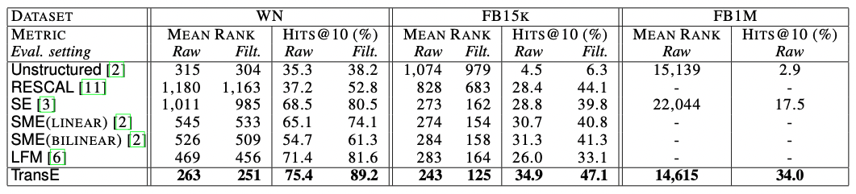
Experiments
Data sets
Wordnet, Freebase
Evaluation protocol
hits@10 : the proportion of correct entities ranked in the top 10.
Baselines
Unstructured, RESCAL, SE, SME(linear)/SME(bilinear) and LFM
Link Prediction Result

Slide 22
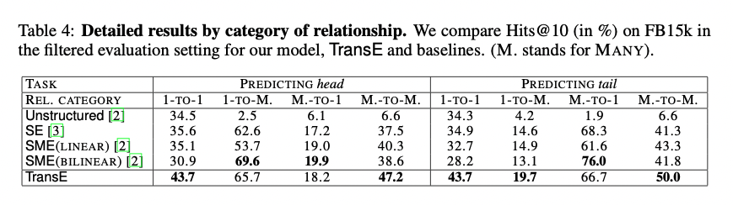
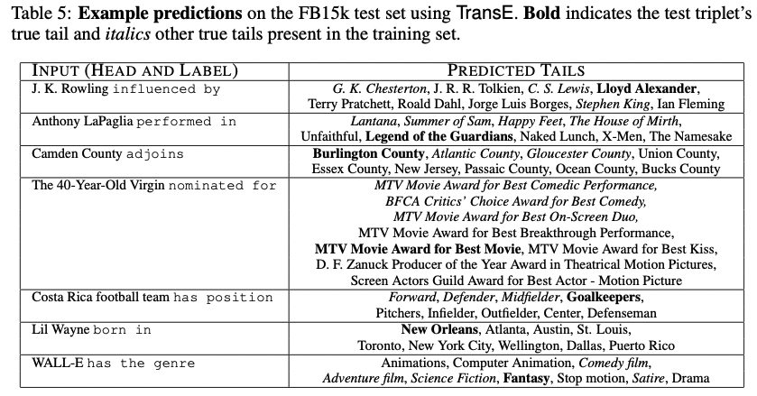

Slide 23
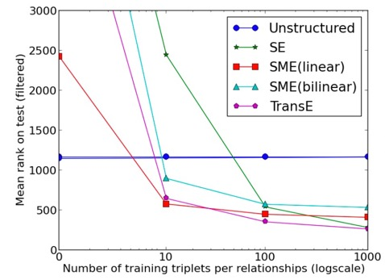
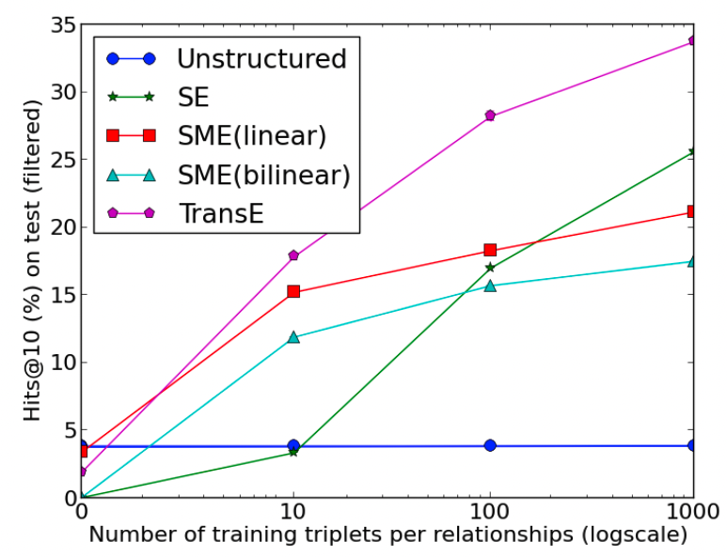
Learning new relationships with few examples

Slide 24
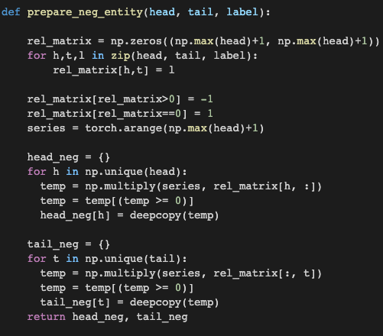


Implementation of the code
max + 1 = length
because unique_head is arithmetic sequence with step size = 1

Slide 25
Implementation of the code
rel_matrix is an adjacent matrix filled with
relationship l if l exists for the head and tail pair. Filled with zero otherwise.
Head and tail pair with relationships
(correct pair)
Potential corrupted set
Element-wise multiplication of the series
by the relation matrix of the particular head
Only the potential corrupted set pairs left

Slide 26
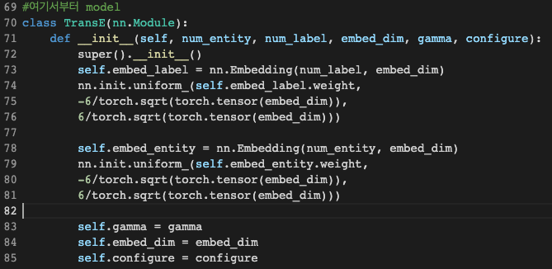
Implementation of the code
Xavier Initialization

Slide 27
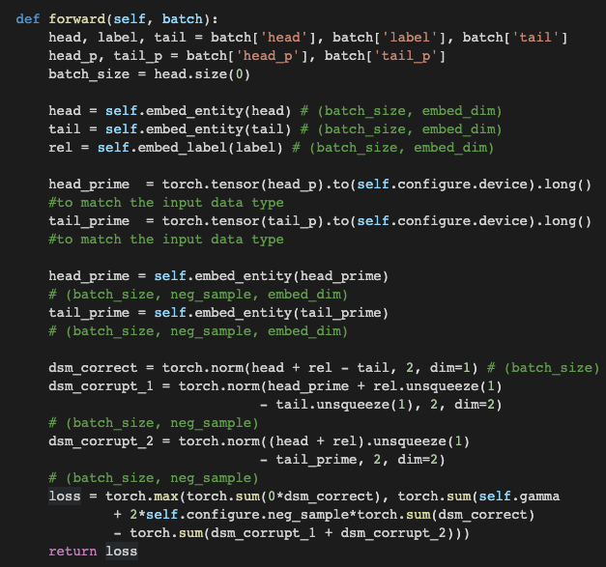
Implementation of the code
Unsqueezed to match the dimension and calculated norm along the embed_dim axis
max(0,b) function to implement the function of returning only the positives.
For each positive set, there are 2 corrupted set(h_p, t_p) each with configure.neg_sample # of neg samples. Thus, 2 x #neg_sample

Slide 28
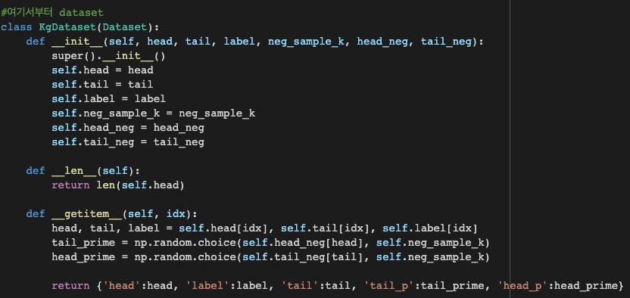
Implementation of the code

Slide 29
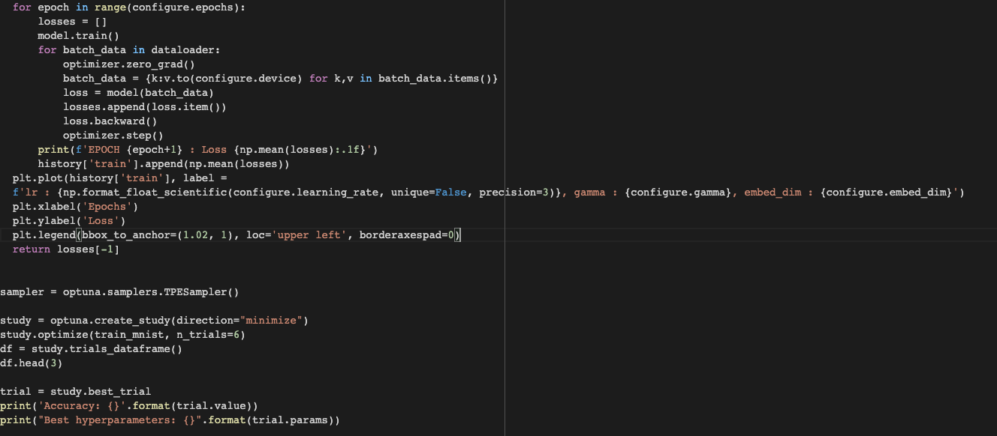
Implementation of the code

Slide 30
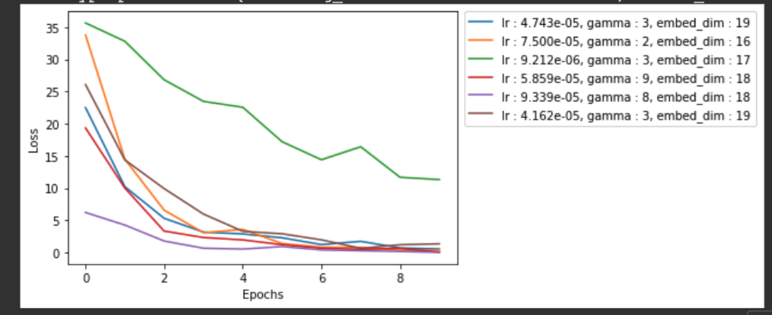
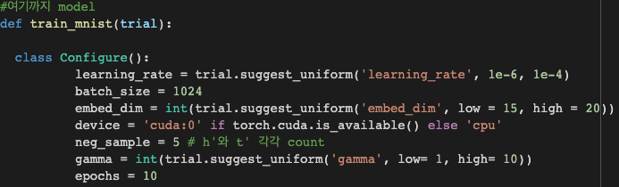
Hyperparameter Tuning

Slide 31
Summary&Conclusion
TransE is an approach to learn embeddings of KBs, focusing on the minimal parametrization of the model to primarily represent hierarchical relationships.
TransE is highly scalable model, as shown through the application of a very large-scale chunk of data
Even in complex and heterogeneous multi-relational domains simple yet appropriate modeling assumptions can lead to better trade-offs between accuracy and scalability.
The greater expressivity of these models comes at the expense of substantial increases in model complexity which results in modeling assumptions that are hard to interpret, and in higher computational costs.

Slide 32
THANK YOU

